Slide 1
What Are You #WorkingFor?
Riding out the storm ‒ Investing in market uncertainty
Date 2020
Notes:
Presenter: Hello, my name is [NAME] and I work for ADP Retirement Services, the recordkeeper for your retirement plan.
Welcome to What Are You #WorkingFor? Riding the Storm Out: Investing in Market Uncertainty.

Slide 2
What Are You #WorkingFor?
Notes:
Presenter: What are you working for? Most days, it’s a simple question that can have many answers. However when dealing with market downturns and volatility you can start to question if the effort is worth the outcome.

Slide 3
Agenda
Strategies to navigate uncertain market conditions
Stay focused
Stay invested
Stay prepared
Stay diversified
Notes:
Presenter: Today we are going to review some time-tested objectives you can use to gain perspective and keep your retirement strategy on track during any volatile market period.
Stay focused. Look back at how stock markets have acted in the past. As we all know, past performance does not indicate future results, but it can provide important perspective.
Stay invested. Do not panic, sell off your stock funds or try to time the market, which I’ll describe in a bit. Many people benefit by working with their financial advisor to assess their long-term investing strategy during volatile periods.
Stay prepared. Understand and put into action strategies to help prepare for a market downturn and then regularly review these strategies.
Stay informed. Be sure to review the account management tools to keep your account on track. You should also review your retirement plan account regularly. It’s important for your investments to be aligned with your tolerance for risk and time horizon to retirement.

Slide 4
Stay focused

Slide 5
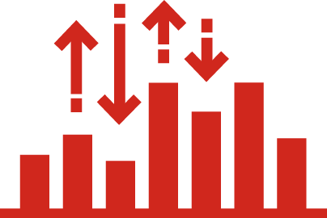
Stay focused
Stock market movement (ups and downs) is natural
Investment value may be up or down depending upon market conditions
Notes:
Presenter: The ups and downs of the stock market are natural and happen for a number of reasons, such as health-related news, economic downturns, political upheaval and even negative company or industry-specific news
As a result of stock market fluctuations, an investment’s value may be up or down.
ADVANCE TO NEXT SLIDE

Slide 6
Highs and lows of investing
Stock market movement is natural
Investing can be emotional
Do not buy high and sell low
Notes:
Presenter: It’s natural for the stock market to fluctuate much like the weather with periods of highs and lows. Investing and emotions often go hand in hand. No one wants to see the value of their savings decline, especially since your savings is intended to supplement your income in retirement. Investing for retirement is a long-term commitment. Making emotional decisions could impact your short and long-term financial goals.
In the financial world, what goes up may come down and what goes down has historically rebounded.
ADVANCE TO NEXT SLIDE

Slide 7
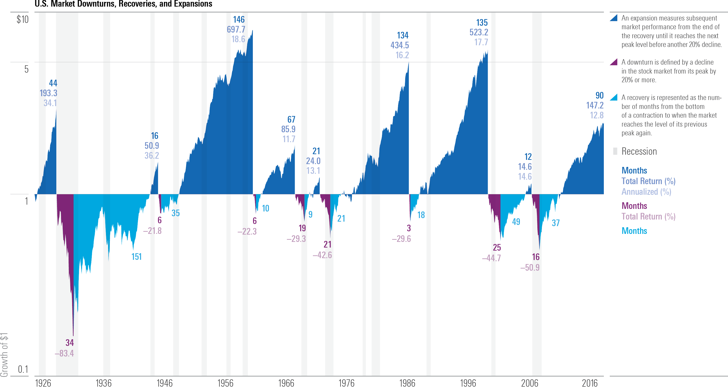
Stay focused
U.S. Market Downturns and Recoveries since 1926
Source: Stocks—Ibbotson Associates SBBI U.S. Large Stock Index. ©2019 Morningstar. All Rights Reserved.
An expansion measures subsequent market performance from the end of the recovery until it reaches the next peak level before another 20% decline
A downturn is defined by a decline in the stock market from its peak by 20% or more
A recovery is represented as the number of months from the bottom of a contraction to when the market reaches the level of its previous peak again
Notes:
Presenter: There have been 8 downturns since 1926, which marked the start of the Great Depression. During this time stocks lost over 80% of their value. During the recent 2007-2009 bear market, stocks lost 50.9%; this downturn lasted for 16 months, and the stock market recovered after 37 months, in March 2012.
Sometimes stocks recover their value quickly, while other times the decline lasts for a while. The recovery period may be painfully long. Because no one can predict market declines with certainty, a diversified portfolio may be the best solution for a long–term investor who is concerned about both return and risk.
Returns and principal invested in stocks are not guaranteed. Diversification does not eliminate the risk of investment losses.

Slide 8
Stay invested

Slide 9
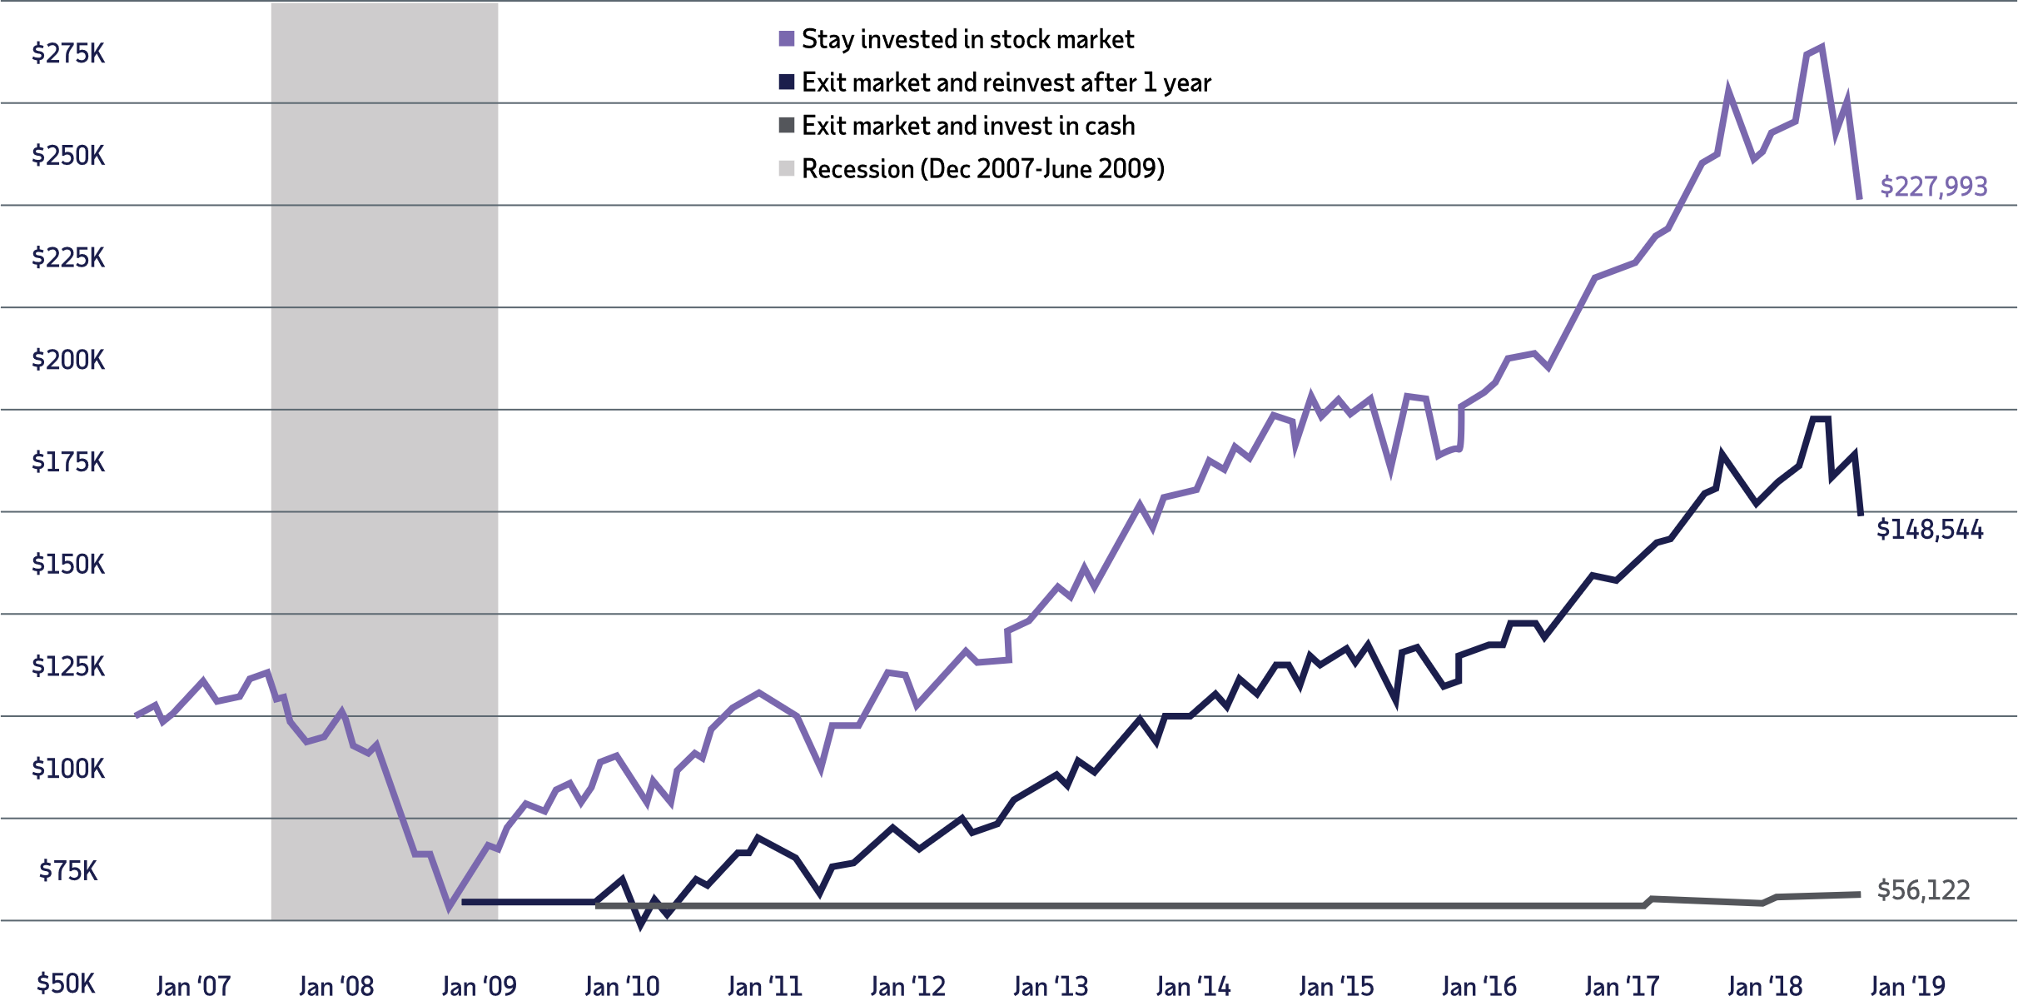
Importance of staying the course
Recession data is from the National Bureau of Economic Research. The market is represented by the Ibbotson® Large Company Stock Index. Cash is represented by the 30-day U.S. Treasury bill. An investment cannot be made directly in an index. The data assumes reinvestment of income and does not account for taxes or transaction costs. Past performance is no guarantee of future results. This is for illustrative purposes only and not indicative of any investment. An investment cannot be made directly in an index. © Morningstar. All Rights Reserved.
Notes:
Presenter: Let’s look at an example of $100,000 invested in the stock market during the 2007–2018 period, which included the global financial crisis in 2007-2008 and the recovery that followed.
By February the investment dropped to $54,381. By staying the course and remaining invested the stock market over the next nine years, the ending value would have been $227,993.
If you decided to exit the market at the bottom and invest in cash for a year, then reinvested, your ending value would have been $148,554. An all-cash investment at the bottom of the market would have yielded only $56,122.
The continuous investment recovered its initial value over the next three years and provided a higher ending value than the other two strategies. All recoveries may not yield the same results so it’s important to stick with a long-term approach to investing.
Returns and principal invested in stocks are not guaranteed. Stocks have been more volatile than bonds or cash. Holding a portfolio of securities for the long term does not ensure a profitable outcome and investing in securities always involves risk of loss.

Slide 10
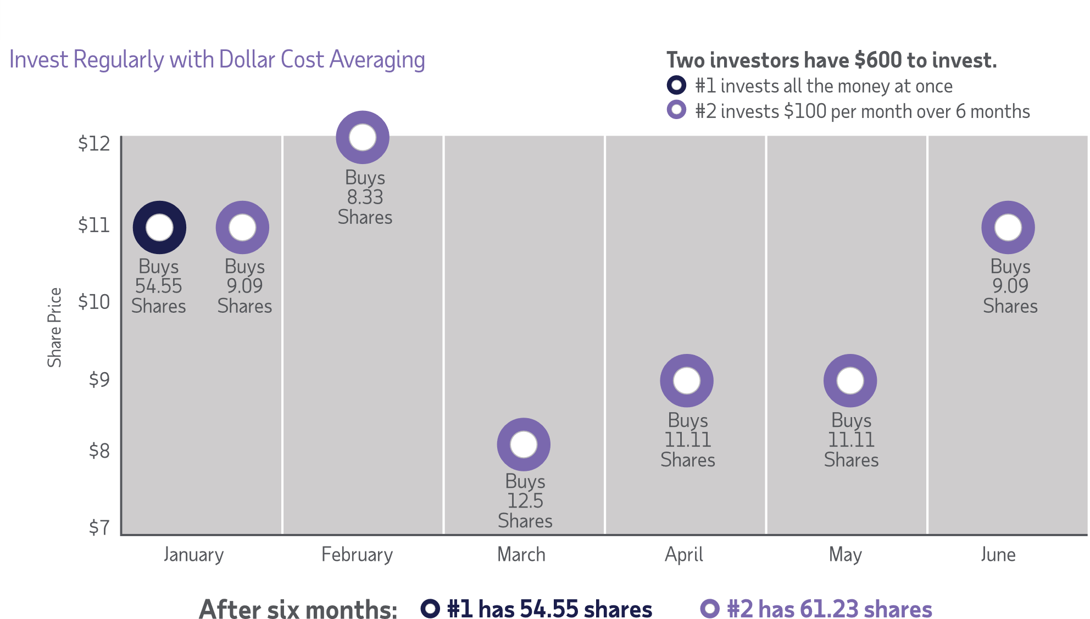
Invest regularly from each paycheck
Dollar cost averaging does not guarantee a profit or protect against loss in a declining market, so you should consider your ability to continue investing through periods of adverse market conditions.
Notes:
Presenter: Let’s talk about the benefits of regular investing. When you contribute to the retirement plan, your money is being invested each paycheck and purchasing shares of your investments at different prices, regardless of market activity. This is also known as dollar cost averaging. This regular investing is one way you can combat the urge to “time the market” and to chase investment returns.
With the strategy of dollar cost averaging, you invest a fixed amount from each paycheck (or at regular intervals). When prices are low, you automatically buy more shares of investments and when prices are up, you buy fewer shares of those more “expensive” shares. If you take advantage of market declines, it can result in owning more shares. Let’s take a look at the example on the slide [review slide]
Dollar cost averaging does not assure a profit or protect against loss in declining financial markets.

Slide 11
Stay prepared

Slide 12
Investing for retirement
Your ideal retirement portfolio should be a mixture of investments with the combination of risk and return for your goals
Factors that help determine which asset allocation is best for you:
Age
Time until retirement
Comfort level with risk
Financial goals
Calculator is available online at mykplan.com/account balance/planning tools/calculators/asset allocation profiler
Asset allocation and diversification do not assure or guarantee better performance and cannot eliminate the risk of investment losses.
Notes:
Presenter: In addition to staying focused and invested, you want to be prepared.
Your ideal retirement portfolio should be a mixture of investments with the right combination of risk and return for your goals, your age and your tolerance for risk. Take advantage of the Asset Allocation Profiler calculator located in the planning tools section under account balance once you have logged into your retirement account.
You will need to answer a number of questions related to your investment objectives, personal finances and risk tolerance to generate a suggested allocation based on your responses.

Slide 13
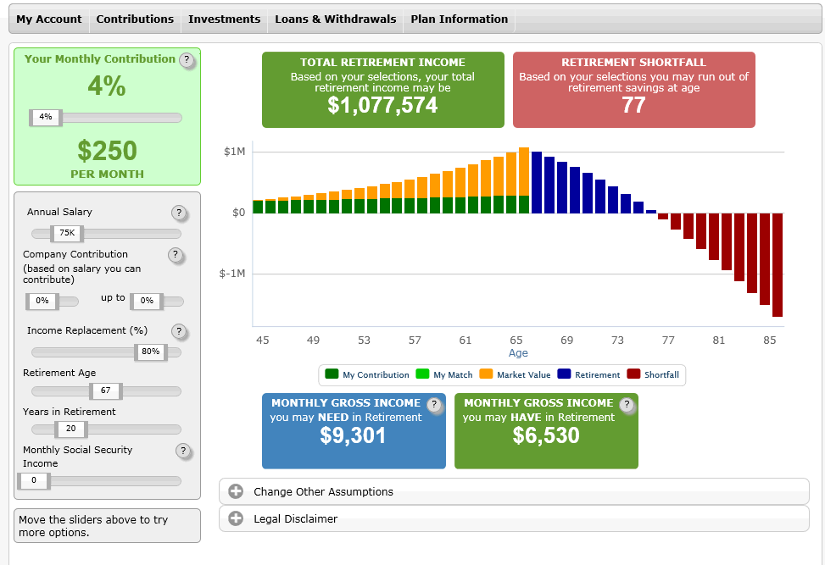
Identify your income needs
Make the most of your benefits and saving ability
Calculate your retirement savings
Determine your Social Security benefit
For illustrative purposes. This is a hypothetical example for a sample participant. The data represented in the chart does not assume investment in any specific fund, your results may be more or less.
IMPORTANT: The projections or other information generated by the Retirement Savings Tool (RST) regarding the likelihood of various retirement savings outcomes are hypothetical in nature, do not reflect actual investment results and are not guarantees of future results. Results may vary with each use and over time. The information used by the RST to make projections is your age, current annual compensation, account balance, and contribution rate. You can change the variable inputs to model different scenarios. RST is provided for educational purposes only. You should not rely on RST as the primary basis for your investment, financial, or tax planning decisions.
13
Notes:
Presenter: You can also take advantage of the Retirement Calculator to determine how long your savings will last. Located on the homepage once you have logged into your retirement account, this interactive calculator allows you to project your potential retirement income and will identify if this will meet or fall short of your needs. Factors such as salary, current contribution, retirement age and desired income replacement can be adjusted based on your personal situation. This tool is located on the home page once you have logged into you account.

Slide 14
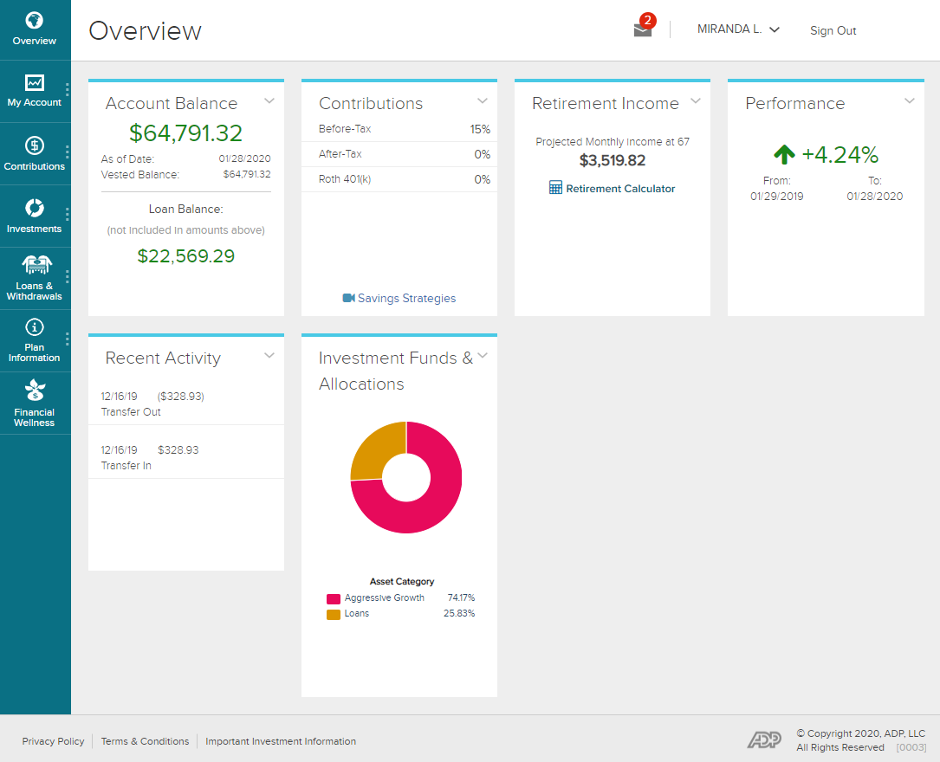
Let your statement be your guide
Your retirement account provides a progress report of your financial wellness
Online you can get the following information:
Account balance
Contribution percentage
Personal performance (rate of return)
Investment funds and allocation information
ADP, LLC owns and operates the ADP.com website and ADP mobile app. ADP, LLC is a retirement plan record keeper and is responsible for the content as shown. Illustrations are representative of technological features only and are not meant to reflect any specific investment strategies nor any account or investment options.
Notes:
Presenter: Be sure to monitor your plan investments against your desired asset allocation. You can assess your saving and investing progress online and through your quarterly account statement.
Here are some things to check:
Account Balance — has it changed much from last year?
An account of your investments — how much money is invested in each individual fund?
Asset Allocation Summary — take a look at your asset allocation. Do you need to change it? Are you too conservative or aggressive? Do you want to change future allocations?
Investment Performance – shows how the various investments in your portfolio performed.
In addition to you quarterly statement, at any time you can go online and click the Retirement Account Highlights button in your account. This summary provides a quick overview of your retirement readiness. It offers a progress report on your overall account activity, your personal rate of return, information on your current asset allocation and a summary of your investments and their performance.

Slide 15
Keeping your assets on track
Experts recommend reviewing your asset allocation at least annually
Review and evaluate your account:
After major “life changes” ( i.e. new job, change in marital status, birth of a baby)
As your investment time frame changes
After major market changes
Notes:
Presenter: It’s important for you to review your portfolio, at least annually.
As part of this process, be sure to assess your asset allocation. Does it still aligns with your goals? Have you had any life changes or moved into the 5 years before retirement? Has the market shifted dramatically? Your portfolio should reflect a mix of investments that aligns with your current risk tolerance, personal financial situation and goals for retirement.
ADVANCE TO NEXT SLIDE FOR # 3 & 4

Slide 16
Keeping your assets on track
Consider lowering risks gradually
Rebalance your retirement account
Consider electing the "Automatically Rebalance My Account” feature for your retirement account
Notes:
It’s a good rule of thumb to lower your risks gradually. Someone just starting his/her career can potentially take on more risk than someone who is approaching retirement.
Consider electing the Automatically Rebalance My Account feature offered in your account. This tool will ensure your asset allocation selection is adjusted according to your preferences.
ADVANCE TO NEXT SLIDE FOR AUTO REBLANCE TOOL

Slide 17
Investing for retirement
Automatically Rebalance My Account
Compare your current account allocation to your desired allocation
Decide whether to move your balances
Rebalance your account as often as you choose
Quarterly
Semi-annually
Annually
Keep in mind that rebalancing your funds could mean potential sales charges or other fees. Additionally, switching out of an investment when the market is doing poorly means locking in the loss. Be aware that if your investments have increased in value, selling them to rebalance your portfolio in a taxable brokerage account could result in your having to pay capital gains taxes.
Notes:
Presenter: Your plan offers an account management feature called Automatically Rebalance My Account. This feature will keep your asset allocation in balance according to your most recent investment elections. You can elect to rebalance your account quarterly, semi-annually or annually.
Notes (from LUMIN: ARB Features, Settings and Timing)
Regular and model portfolio rebalancing occur at the same time.
Auto rebalancing does not include stock and self-managed accounts (SDA/Brokerage) .
Market timing restrictions are not affected when automatic account rebalancing occurs.
Redemption fees are not incurred when automatic rebalancing occurs
Rebalancing is based on the asset allocation set on the day of the rebalancing process. It is run mid-month at the frequency desired.
Account rebalancing can be chosen to occur in one of the following three time frames:
Annual rebalancing would occur on December 15th (or the next business day thereafter).
Semi-annual rebalancing would occur on June 15th and December 15th (or the next business day thereafter, respectively).
Quarterly rebalancing would occur on (March 15th, June 15th, September 15th, and December 15th. (or the next business day thereafter, respectively).

Slide 18
Stay informed

Slide 19
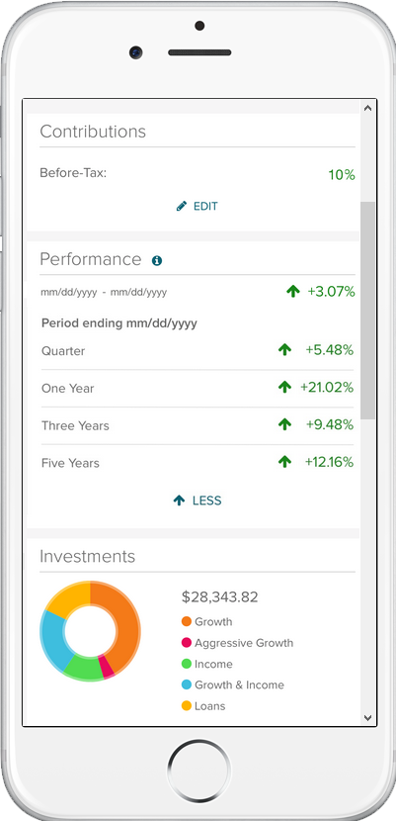
Information in the palm of your hand
ADP Mobile App¹
ADP’s Mobile Application provides a convenient and fast way to access to your 401(k) information. Download it today and get started.
The easy-to-navigate dashboard allows you access to account information and allows you to perform certain account transactions – all on your mobile device.
This screen is representative of website features and is not meant to reflect any specific investments or customer account.
Notes:
Presenter: If you have not already, I encourage you to download the ADP Mobile App. In our fast-paced lives, this app will provide you with convenient and fast access to your retirement plan account. You can perform certain transaction and access additional financial wellness tools through the App.

Slide 20
Advisory services available through Financial Engines
Independent investment advisor
Three tiers of services are available
Self-Service Do-it-yourself online retirement planning & support Available at no additional cost | Management Automated retirement planning, management & guidance This is a fee-based service | Personal Advisor Financial planning & management of your 401(k) and outside accounts This is a fee-based service
Participant advisory and management services provided by Financial Engines Professional Management is made available to plans recordkept by ADP, LLC (“ADP”), however Financial Engines is not affiliated with ADP nor any of ADP’s affiliates, parents, or subsidiaries. ADP provides technology services that facilitate a plan’s connectivity to the services of Financial Engines and provides information about Financial Engines’ services to you; however the provision of these services is in no way a recommendation or endorsement by ADP of Financial Engines, nor does it imply a certain level of skill or services offered by Financial Engines.

Slide 21
Preparing for retirement – the long-term forecast
Stay focused
Historically the stock market has weathered the storm and has rebounded after periods of downturns
Stay invested
The journey to retirement is not a sprint. Stay the course and maintain your investment strategy for the long-term
Stay prepared
Your investments should be a combination of risk and return that align with your goals.
Stay diversified
Monitor your investments against your desired asset allocation. Review your account regularly and take advantage of the account management tools in your Plan
Notes:
Presenter: Preparing for retirement involves staying focused as historically the stock market has rebounded after periods of downturns. Stay invested as the journey to retirement is not a sprint. Stay prepared by making sure your investments align with your goals and are rebalanced regularly Stay diversified by monitoring your investment against your desired asset allocation.
To help you ride out the storm, be sure to take advantage of the online tools and resources available by logging into your account today,
[Optional for polling or to use via a webcast or onsite meeting]
Before we wrap up today, I’d like to ask you one question: the next time stock prices fall, will you most likely…
Stay focused on what the stock market has done in the past to maintain perspective
Stay invested and maintain a strategy for long-term savings
Stay prepared and align your investments with your risk and return goals
Stay informed and take advantage of the account management tools offered in your Plan
All of the above?

Slide 22
Investment returns and principal value of an investment will fluctuate so that, when an investor’s shares are redeemed, they may be worth more or less than the original cost. Past performance is no guarantee of future results.
ADP, LLC is a retirement plan record keeper and is not associated with your employer. By delivering this material, ADP, LLC, its affiliates and their employees (“ADP”) are merely providing an educational service to your company in accordance with the terms of ADP’s contract with your employer.
Investment options are available through the applicable entity(ies) for each retirement product. Investment options in the “ADP Direct Products” are available through either ADP Broker-Dealer, Inc. (ADP BD), Member FINRA, an affiliate of ADP, LLC, One ADP Blvd, Roseland, NJ 07068 or (in the case of certain investments) ADP, LLC. Only licensed representatives of ADP BD may offer and sell ADP retirement products and services or speak to retirement plan features and/or investment options available in any ADP retirement products. Registered representatives of ADP Broker-Dealer, Inc. do not offer investment, tax or legal advice to individuals. Please consult with your own advisors for such advice. Nothing contained in this communication is intended to be, nor should be construed as, particularized advice or a recommendation or suggestion that you take or not take a particular action.

