Slide 1
Weathering the storm
How a financial wellness program
can help you and your employees
Date | Location
Copyright © 2020 ADP, LLC. Proprietary and Confidential. For PLAN SPONSOR Use Only — Not for Distribution to the Public.
Notes:
Presenter: Hello. Welcome to our program about the importance of a financial wellness program and how it can help you and your employees weather the uncertainty of market volatility.
Thank you for joining me today [introduction]
We are living in a time of unprecedented uncertainty. The worldwide economic impact of the COVID-19 outbreak will reach every industry, every business, every person.
There are tough times ahead, but being prepared and having trusted advisors you can turn to can help you and your employees prevail in times of turmoil.

Slide 2



Agenda
What is financial wellness?
Strategies to navigate uncertain
market conditions
Retirement plans designed
for life’s challenges
Notes:
Presenter: Today we are going to discuss financial wellness and review some time-tested strategies that can help you and your employees stay on track during any volatile market period. And then, we will discuss how ADP can help you and your workforce prepare for the challenging times ahead with smart, secure tools that can help you build a secure financial foundation while minimizing administrative risk.

Slide 3





What are your financial goals?
Notes:
Presenter: What are your financial goals? Not always an easy question to answer and can vary greatly based on a person’s situation. What one person is saving for will not be the same as their co-worker. Sometimes simply understanding one’s financial goals helps us set the groundwork for establishing a sound financial wellness strategy.

Slide 4







What is Financial Wellness?
A
B
C
D
A fitness program
A rewards program at my company
Managing expenses as a way to
save toward a future goal
The name of
a YouTube sensation
Notes:
Presenter: You may have been hearing the words Financial Wellness and the buzz around why it’s important. But do you know what it means?
[Note: read each option and take a few seconds to see if any attendee raises a hand]
Let’s see a show of hands if you think it’s:
A fitness program, what about
A rewards program at my company, who thinks it’s
Managing expenses as a way to save toward a future goal, or is it
The name of a YouTube sensation
Advance to next slide for the answer

Slide 5


What is Financial Wellness?
Answer:
C
Managing expenses as a way to save toward a future goal
Notes:
Presenter: The answer is C, managing expenses as a way to save toward a future goal. Future goals can be finding the money to save for a trip, a wedding, college or some other life event. Ultimately, most individual’s final goal will be retirement.

Slide 6




Why is financial wellness important?
Here’s why.
54%
63%
4/10
cant cover a
have less than $25k
$500 surprise expense
live paycheck
saved in retirement
to paycheck
44%
55%
need help
plan to work
with their overall financial wellbeing
past retirement age
Source: PriceWaterhouseCoopers 2017 Employee Financial Wellness Survey
Notes:
Presenter: Why is financial wellness important? Because prior to economic instability caused by COVID-19, 63% of Americans couldn’t cover a $500 surprise expense, 4 out of 10 lived paycheck to paycheck, 54% had less than $25k saved in retirement, 44% planned to work past retirement age and 55% needed help with their overall financial wellbeing.
I know, not very encouraging. And while the impact of COVID-19 has not been fully calculated, it most likely will have a long-term effect on the financial health of millions of Americans. The lack of financial wellness does call attention to the fact there is a need for us to step back from the daily chaos and assess our situation and finances. Taking a hard look at how we spend our money is a great first step. [advance to next slide]

Slide 7

Where does your money go?
Americans are spending on average
$787.28 per month¹
Common items include:
$209.38 for dinner at restaurants
$188.68 for drinks with friends or co-workers
$177.88 for takeout or delivery services
$173.62 buying lunch
$108.97 on impulse purchases.
$96.11 for rideshare trip
$20.25 for coffee
$17.47 for bottled water
1 Source: Yahoo! Finance Americans Spend $18,000 Per Year on Non-Essentials, May 6, 2019
Notes:
Presenter: Prior to the pandemic, American’s were spending on average each $787.28 month on many common items. [NOTE: read a few items from the slide, not all of them]
Having money to save is an important part of being financially fit. According to a 2019 survey by Debt.com, 33% of Americans do not budget, yet 93% agree that a budget is necessary¹. When individuals honestly track their spending habits, they may be surprised by how much they are spending on lunch or those impulse purchases. Most of all, once individuals know where they are spending their money, they are in a better position to identify funds for saving for their future goals like retirement.
Part of being financially fit includes saving for long-term goals like retirement – which generally involves investing in investment options like mutual funds available in the plan. Let’s review some time-tested investment concepts used o help individuals stay on track during periods of market volatility.
1 Source: Yahoo! Finance Americans Spend $18,000 Per Year on Non-Essentials, May 6, 2019; https://www.debt.com/research/best-way-to-budget-2019/

Slide 8


Stay focused
Notes:
Let’s start with our first concept – stay focused. As we all know, past performance does not indicate future results – but looking back at how stock markets have acted in the past can provide an important perspective.

Slide 9
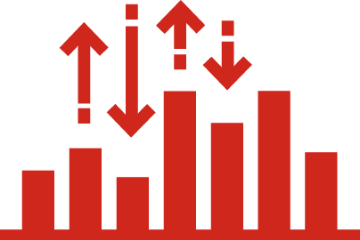
Stay focused
Stock market movement (ups and downs) is natural
Investment value may be up or down depending upon market conditions
Notes:
Presenter: The ups and downs of the stock market are natural and happen for a number of reasons, such as economic downturns, political upheaval and even negative company or industry-specific news
As a result of stock market fluctuations, an investment’s value may be up or down.
In the financial world, what goes up may come down and what goes down has historically rebounded.
ADVANCE TO NEXT SLIDE

Slide 10
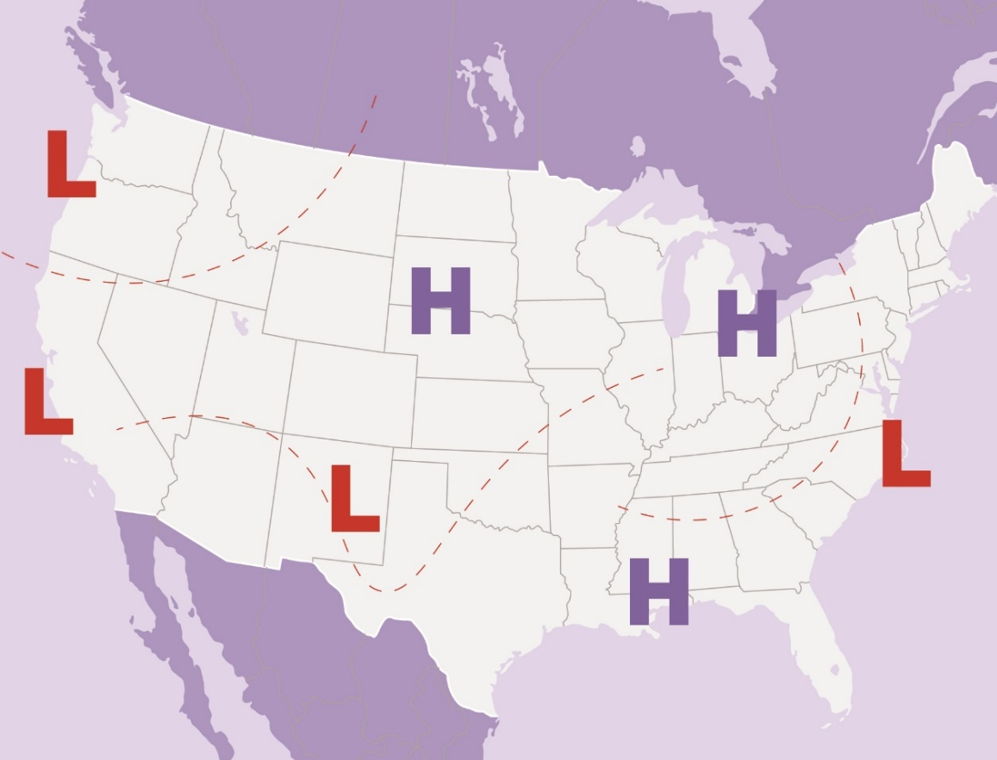
Highs and lows of investing
Stock market movement is natural
Investing can be emotional
Do not buy high and
sell low
Notes:
Presenter: It’s natural for the stock market to fluctuate much like the weather with periods of highs and lows. These market fluctuations happen for a number of reasons, disappointing economic reports, political upheaval and even negative company or industry-specific news. As a result of stock market fluctuations, an investment’s value may be up or down.
Investing and emotions often go hand in hand. No one wants to see the value of their savings decline, especially since your savings is intended to supplement your income in retirement. Investing for retirement is a long-term commitment. Making emotional decisions could impact your short and long-term financial goals.
In the financial world, what goes up may come down and what goes down has historically rebounded.
ADVANCE TO NEXT SLIDE

Slide 11
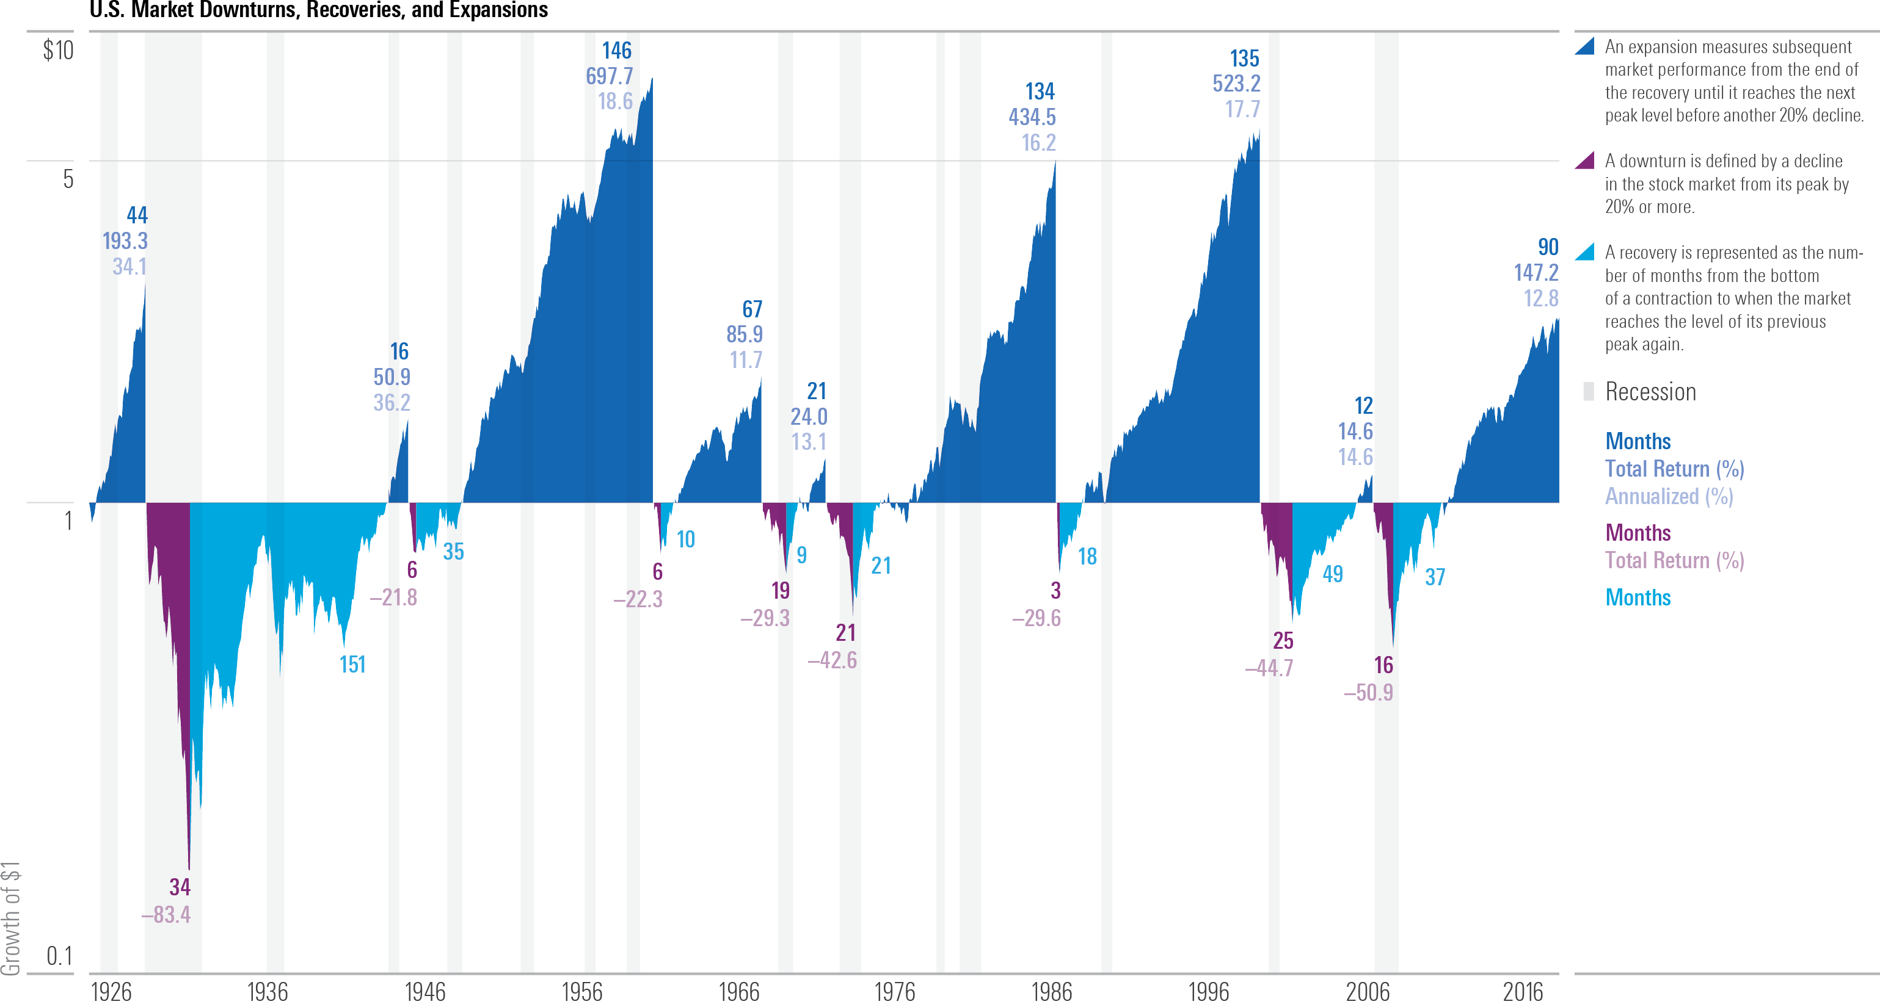

Stay focused
U.S. Market Downturns and Recoveries since 1926
Source: Stocks—Ibbotson Associates SBBI U.S. Large Stock Index. ©2019 Morningstar. All Rights Reserved.
An expansion measures subsequent market performance from the end of the recovery until it reaches the next peak level before another 20% decline
A downturn is defined by a decline in the stock market from its peak by 20% or more
A recovery is represented as the number of months from the bottom of a contraction to when the market reaches the level of its previous peak again
Notes:
Presenter: Not including the most recent market downturn due to COVID-19, there have been 8 downturns since 1926, which marked the start of the Great Depression. During this time stocks lost over 80% of their value. During the recent 2007-2009 bear market, stocks lost 50.9%; this downturn lasted for 16 months, and the stock market recovered after 37 months, in March 2012.
Sometimes stocks recover their value quickly, while other times the decline lasts for a while. The recovery period may be painfully long. Because no one can predict market declines with certainty, a diversified portfolio may be the best solution for a long–term investor who is concerned about both return and risk.
Returns and principal invested in stocks are not guaranteed. Diversification does not eliminate the risk of investment losses.

Slide 12

Stay invested
Notes:
The second concept is stay invested. Not always as easy as it sounds when the market is fluctuating. But, there are strategies you and your employees can use to help minimize the impact of market volatility.

Slide 13
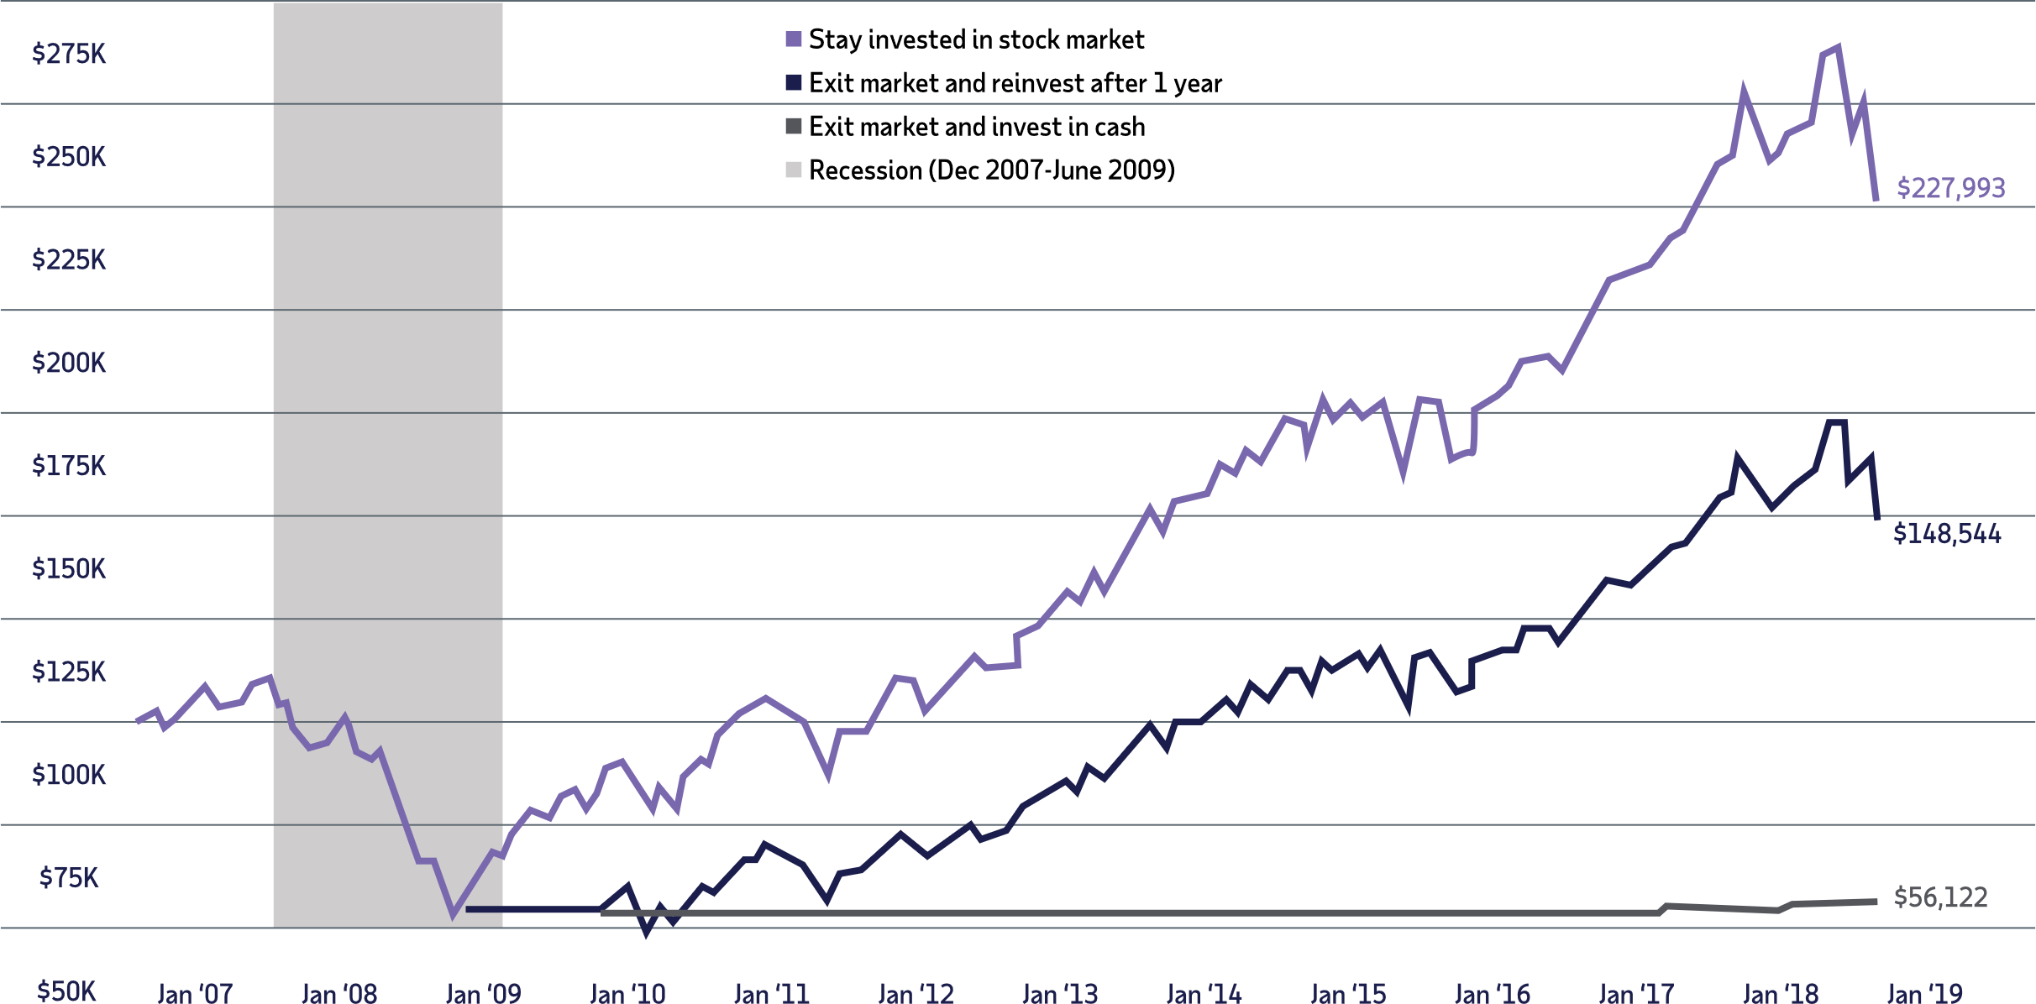
Importance of staying the course
  Recession data is from the National Bureau of Economic Research. The market is represented by the Ibbotson® Large Company Stock Index. Cash is represented by the 30-day U.S. Treasury bill. An investment cannot be made directly in an index. The data assumes reinvestment of income and does not account for taxes or transaction costs. Past performance is no guarantee of future results. This is for illustrative purposes only and not indicative of any investment. An investment cannot be made directly in an index. © Morningstar. All Rights Reserved.
Notes:
Presenter: Let’s look at an example of $100,000 invested in the stock market during the 2007–2018 period, which included the global financial crisis in 2007-2008 and the recovery that followed.
By February the investment dropped to $54,381. By staying the course and remaining invested the stock market over the next nine years, the ending value would have been $227,993.
If an investor decided to exit the market at the bottom and invest in cash for a year, then reinvested, his ending value would have been $148,554. An all-cash investment at the bottom of the market would have yielded only $56,122.
The continuous investment recovered its initial value over the next three years and provided a higher ending value than the other two strategies. All recoveries may not yield the same results so it’s important to stick with a long-term approach to investing.
Returns and principal invested in stocks are not guaranteed. Stocks have been more volatile than bonds or cash. Holding a portfolio of securities for the long term does not ensure a profitable outcome and investing in securities always involves risk of loss.

Slide 14
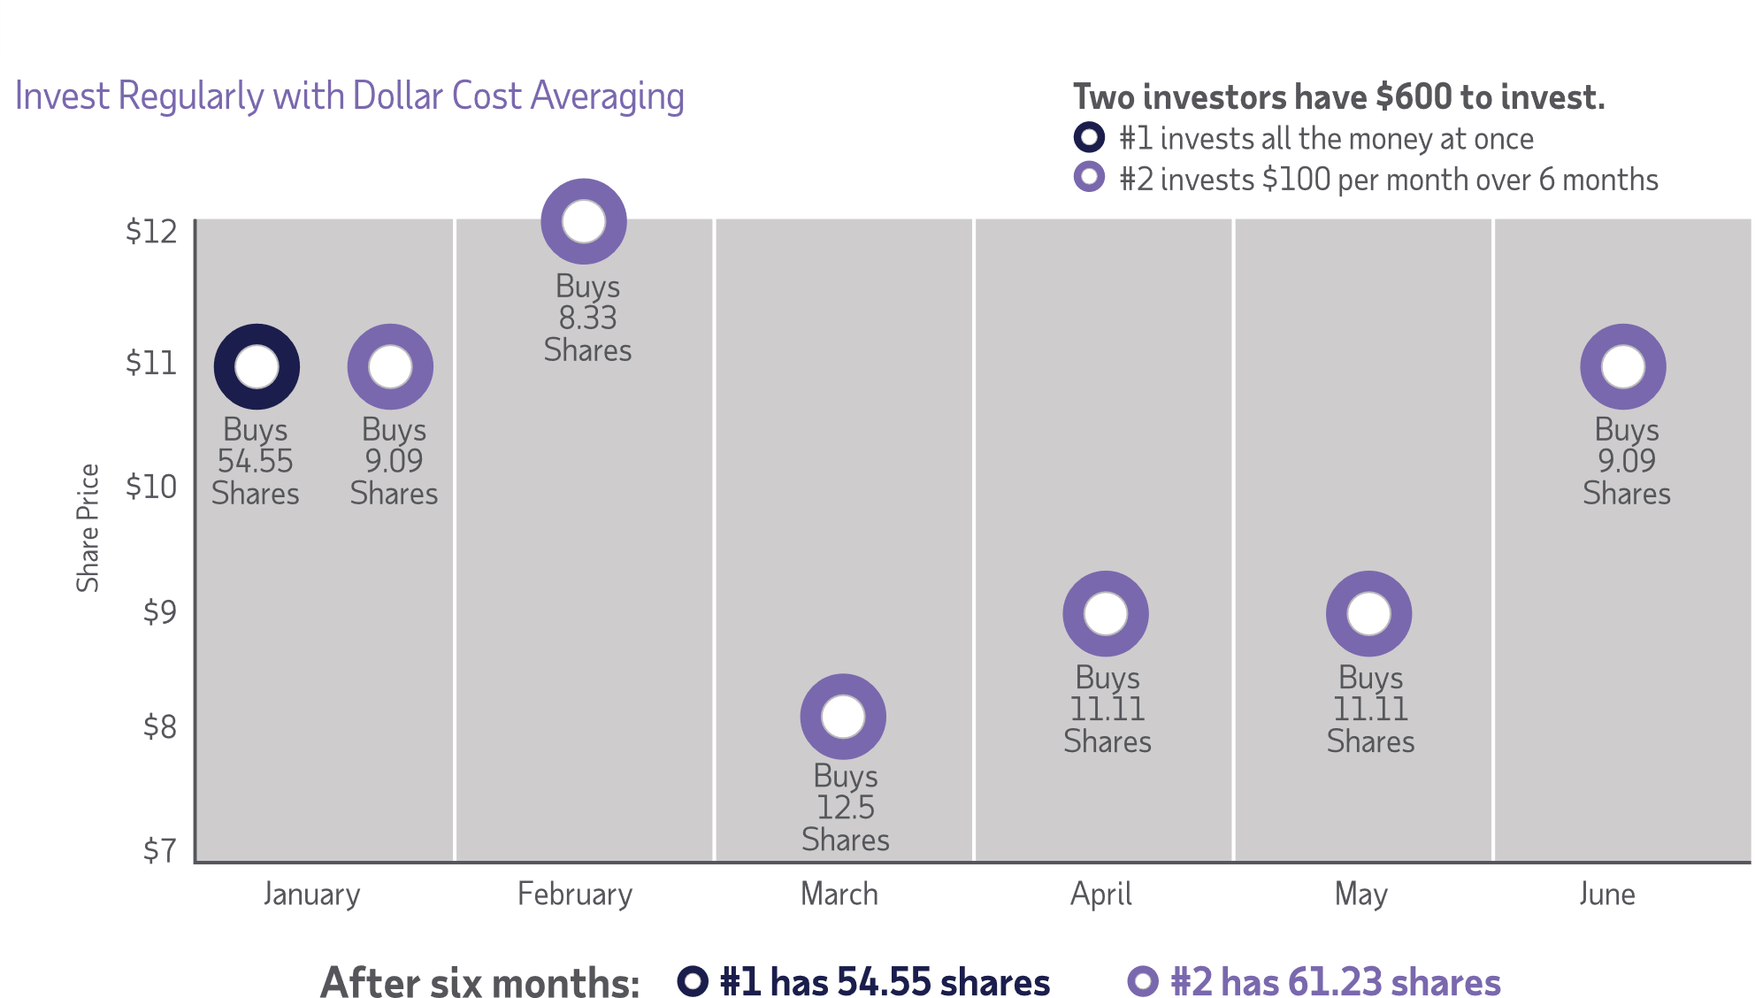
Invest regularly from each paycheck
Dollar cost averaging does not guarantee a profit or protect against loss in a declining market, so you should consider your ability to continue investing through
periods of adverse market conditions.
Notes:
Presenter: Let’s talk about the benefits of regular investing. When you and your employees contribute to your company’s retirement plan, your money is being invested each paycheck and purchasing shares of your investments at different prices, regardless of market activity. This is also known as dollar cost averaging. This regular investing is one way to combat the urge to “time the market” and to chase investment returns.
With the strategy of dollar cost averaging, you and your employees invest a fixed amount from each paycheck (or at regular intervals). When prices are low, you automatically buy more shares of investments and when prices are up, you buy fewer shares of those more “expensive” shares. If you take advantage of market declines, it can result in owning more shares. Let’s take a look at the example on the slide [review slide]
Dollar cost averaging does not assure a profit or protect against loss in declining financial markets.

Slide 15

Stay prepared and diversified
Notes:
The third and fourth concepts are stay prepared and diversified. This involves understanding and putting into action strategies to help prepare for a market downturn and then regularly reviewing these strategies. Plus, ADP has the services and resources to help you and your workforce navigate market volatility and stay on course toward your financial goals.

Slide 16
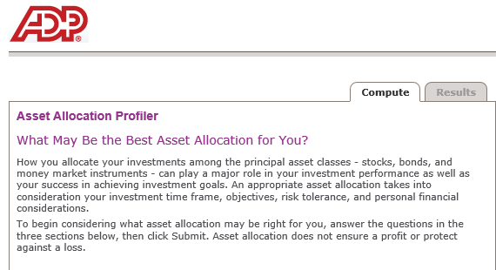
Investing for retirement
  Build an investment lineup with a diversified mix of mutual funds
  Factors that help determine which asset allocation is best for you:
    Age
    Time until retirement
    Comfort level with risk
    Financial goals
Calculator is available online at mykplan.com/account balance/planning tools/calculators/asset allocation profiler
Asset allocation and diversification do not assure or guarantee better performance and cannot eliminate the risk of investment losses.
Notes:
Presenter: In addition to staying focused and invested, you and your employees want to be prepared.
Build an investment lineup with a diversified mix of mutual funds to meet a variety risk and return goals – along with a wide range of ages and tolerance for risk. If the current environment has taught you that your tolerance for risk is not as high as you thought it was, you may want to adjust your portfolio accordingly.
To help, ADP offers an Asset Allocation Profiler calculator located on the participant website. You will need to answer a number of questions related to your investment objectives, personal finances and risk tolerance to generate a suggested allocation based on your responses.

Slide 17

Keeping your assets on track
    Experts recommend reviewing your asset allocation at least annually
    Review and evaluate your account:
    After major “life changes” ( i.e. new job, change in marital status, birth of a baby)
    As your investment time frame changes
    After major market changes
    Consider lowering risks gradually
    Rebalance your retirement account
Notes:
Presenter: It’s important for you and your employees to review your portfolios at least annually.
As part of this process, be sure to assess your asset allocation. Does it still aligns with your goals? Have you had any life changes or moved into the 5 years before retirement? Has the market shifted dramatically? Your portfolio should reflect a mix of investments that aligns with your current risk tolerance, personal financial situation and goals for retirement.
It’s a good rule of thumb to lower risk gradually. Someone just starting his/her career can potentially take on more risk than someone who is approaching retirement.
Consider electing the Automatically Rebalance My Account feature offered in your account. This tool will ensure your asset allocation selection is adjusted according to your preferences.

Slide 18

Designing for life’s financial challenges
Notes:
Presenter: For over 70 years, employers have entrusted ADP to help them run their businesses. We’re pioneers of HR outsourcing and payroll processing — and we’ve led the way in defining the future of business solutions. We’re always innovating to design new and better ways to get work done. We can help you minimize administrative burdens and human resources management overhead through automation and outsourcing – from recruitment to retirement.
ADP can help you and your workforce prepare for the challenging times ahead with smart, secure tools that can help you build a secure financial foundation, simplify administration, and minimize risk.

Slide 19
ADP Achieve: your financial wellness connection
ADP Mobile App*
MyADP Retirement Snapshot**
Participant Website
Financial Wellness Website**
Retirement Health Care Cost Projector**
* The ADP Mobile App is available on the following devices: iPhone®, iPad®, iPod Touch®, iOS v7.0 or higher, or AndroidTM v4.4 or higher.
ADP also offers a website for employees with unsupported mobile devices, available at https://mobile.adp.com.
**See footnotes at the end of the presentation.
Notes:
Presenter: Your employees have a range of needs and a variety of challenges that can keep them from attaining their financial goals. ADP helps employees prepare for challenging times right from the start with mobile tools that make it easy for them to start their journey to financial wellness. Achieve not only provides a strong financial wellness foundation but it also prompts employees to take action….now.

Slide 20
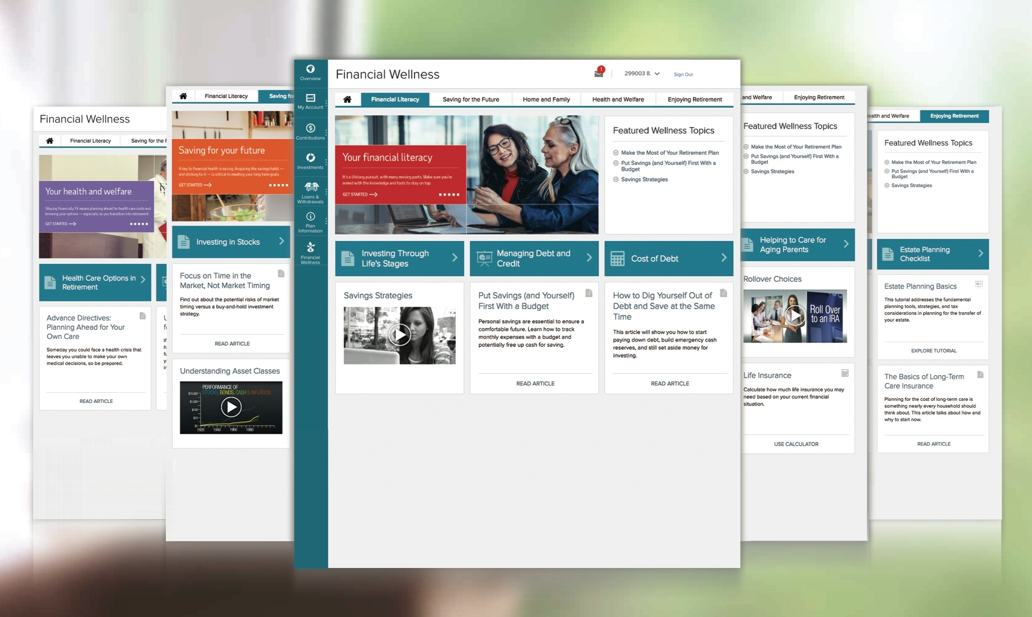
Financial Wellness Program
Notes:
Presenter: Our financial wellness program has a library of helpful learning resources in a variety of media including videos, articles, calculators that cover a range of topics. Accessible through the retirement savings website, the site includes financial wellness information about “Saving for the Future,” “Home and Family,” “Health and Welfare,” “Enjoying Retirement,” and “Financial Literacy.”

Slide 21
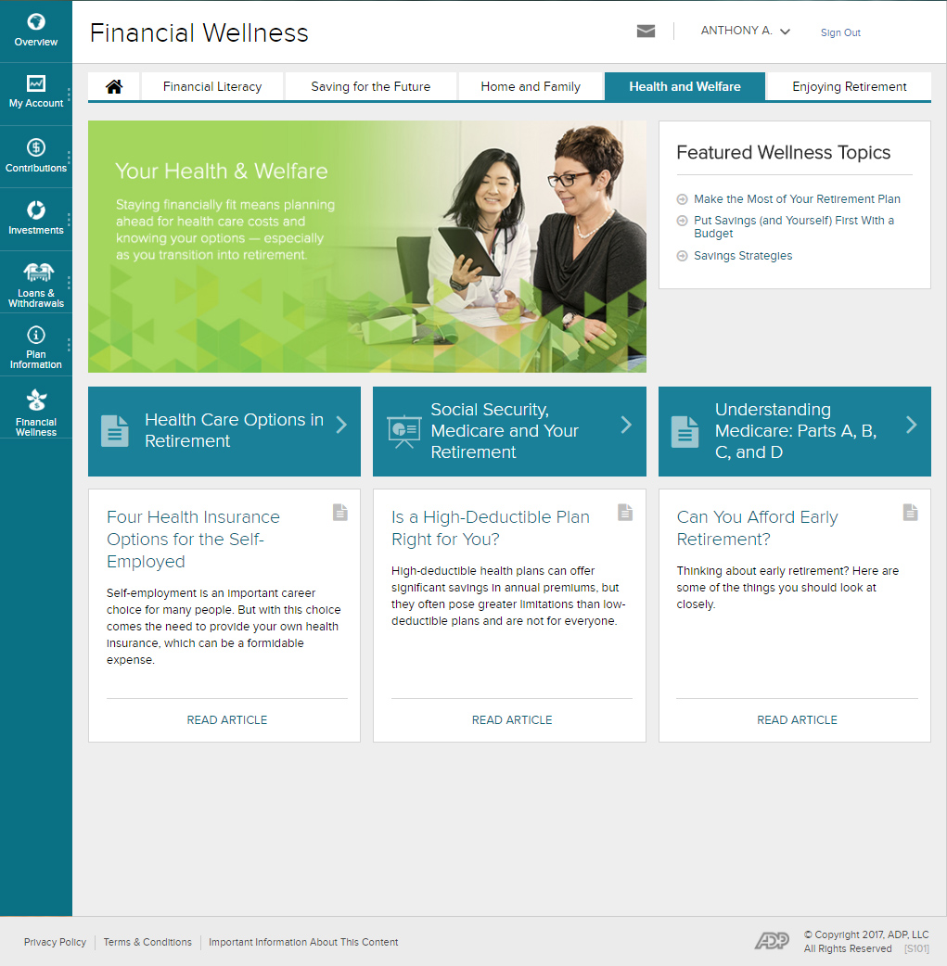
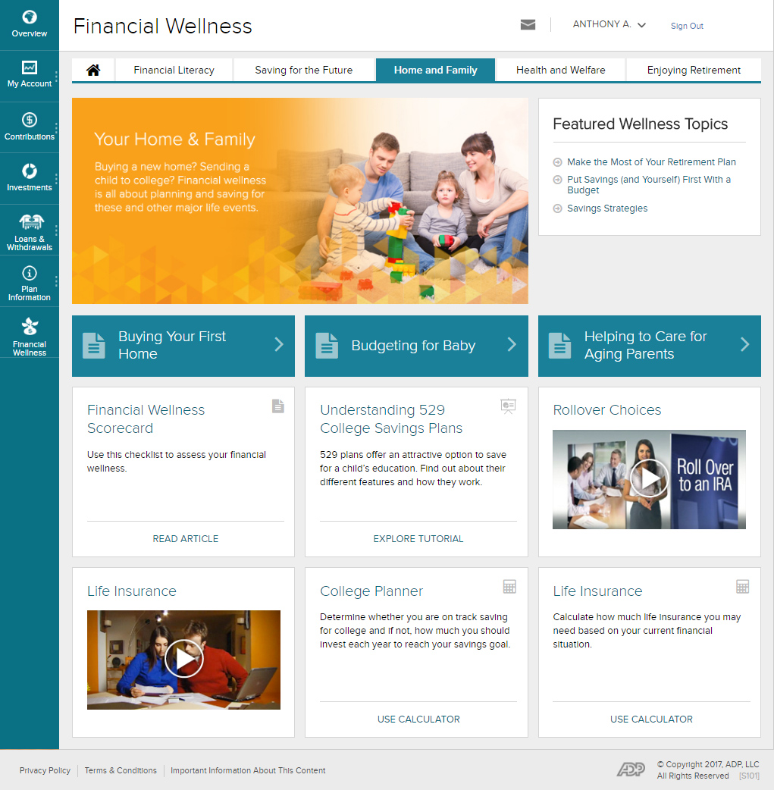
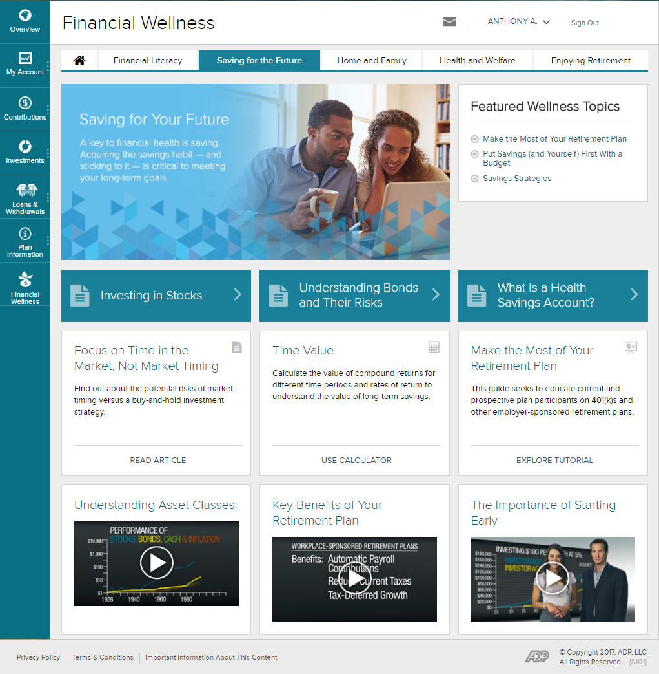
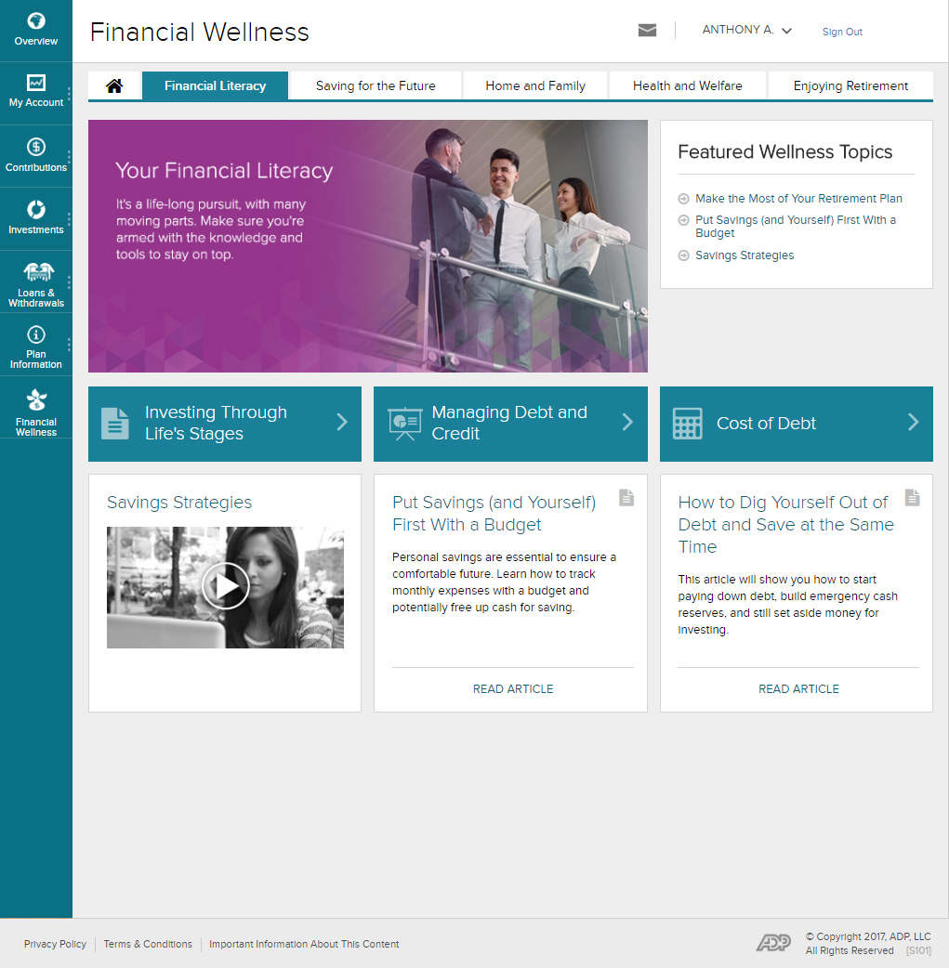
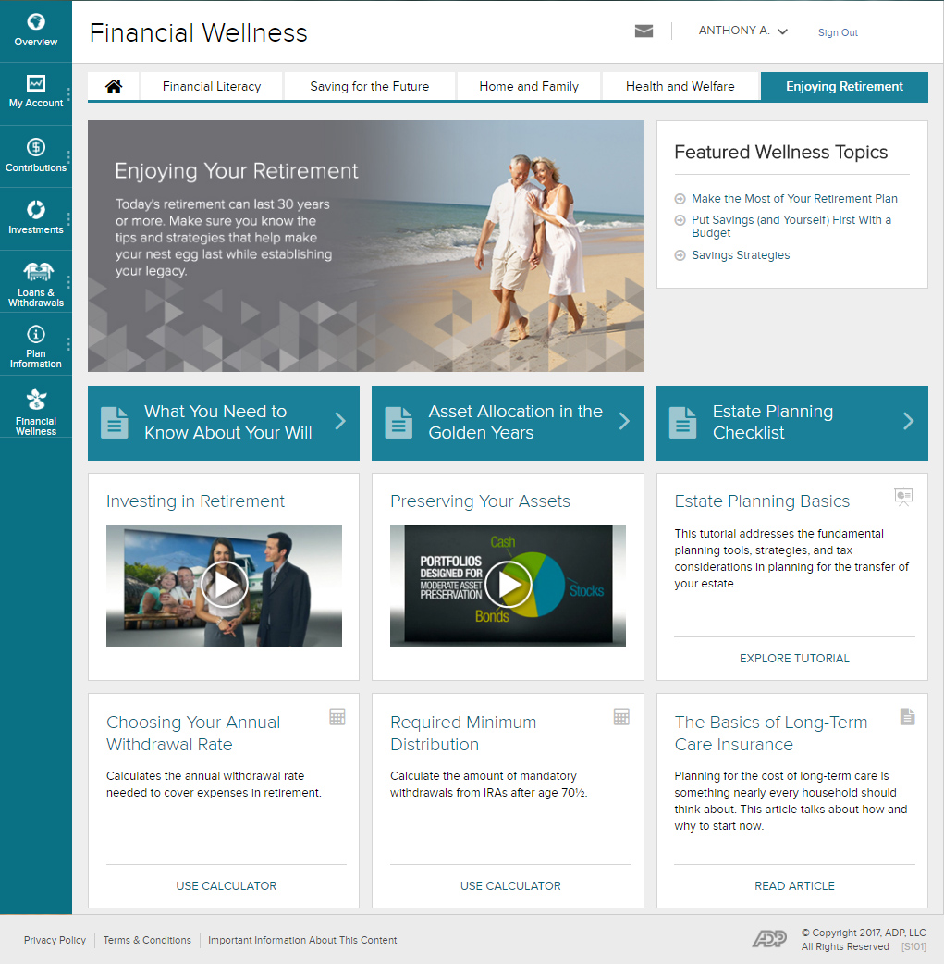
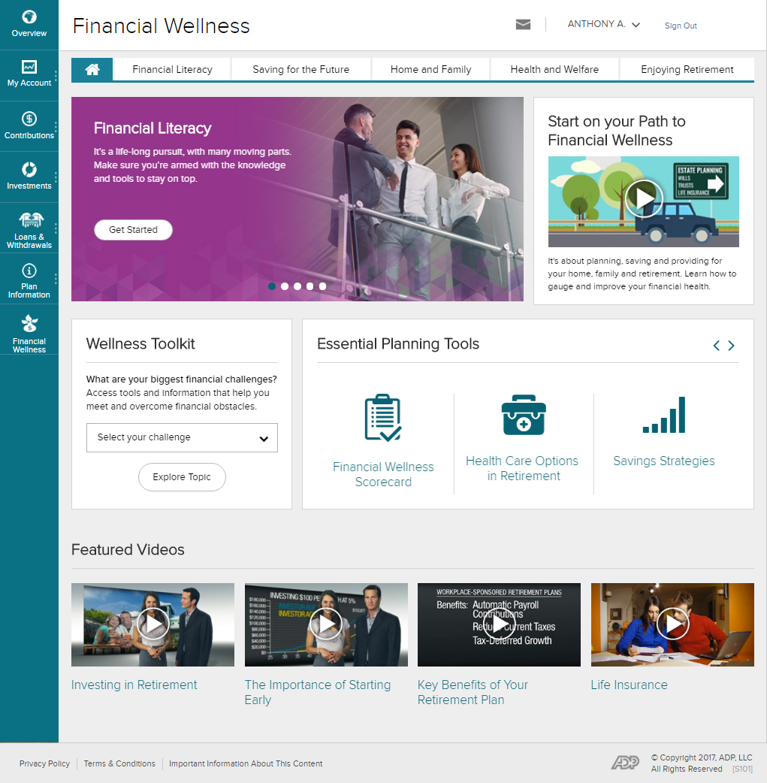

Start with financial wellness
  Content
  helps participants prepare for life’s challenges
  Financial literacy
  Saving for
  the future
  Home and family
  Health and welfare
  Enjoying retirement
Notes:
Presenter Helping your workforce get retirement ready starts with preparing them for all of life’s financial challenges. Workers of all ages are overwhelmed by debt, managing day-to-day expenses, and saving for milestones like owning a home, funding a college education and retirement.
ADP’s financial wellness program can help employees face their financial decisions with confidence. Accessible through the participant web site, your employees will find a library of digital tools and educational information about planning, saving, and providing for their home, family, and retirement. With financial education, employees can make better choices and set realistic goals.

Slide 22


ADP Marketplace
The ADP Marketplace brings together well-known brands that employers can add to their financial wellness programs. With these innovative financial planning applications, workers can make smarter, more informed decisions about their finances.
ADP wins
‘Awesome New
Technology Award’
Fourth Year in a Row 2015-2018!
Let ADP help your employees unlock their potential by providing educational content on:
Financial literacy
Debt management
Retirement planning
Saving for college
The ADP Marketplace is a platform offering a variety of Human Capital Management (“HCM”) applications and services, including financial planning applications, many with pre-built integration to ADP offerings to clients of ADP, LLC. Third party applications, services and integrated solutions are not recommended or vetted by ADP Retirement Services and are not affiliated with ADP Retirement Services, ADP Broker-Dealer, Inc., ADP Strategic Plan Services, LLC.
ADP Takes Home “Awesome New Tech Award” For Record-breaking Fourth Straight Year, September, 2018.
Source: HealthView Services: 2018 Retirement Health Care Costs Data Report, 2018
Notes:
Presenter: Plus, ADP Marketplace, employers can choose which apps will be most beneficial to their workforce. Once you purchase the financial wellness apps, they will integrate with ADP allowing you access to everything you need to manage your people better, from hire to retire.

Slide 23






Advisory services available through Financial Engines®
  Independent investment advisor
  Three tiers of services are available
Self-Service Do-it-yourself online retirement planning & support Available at no additional cost | Management Automated retirement planning, management & guidance This is a fee-based service | Personal Advisor Financial planning & management of your 401(k) and outside accounts This is a fee-based service
Participant advisory and management services provided by Financial Engines Professional Management is made available to plans recordkept by ADP, LLC (“ADP”), however Financial Engines is not affiliated with ADP nor any of ADP’s affiliates, parents, or subsidiaries. ADP provides technology services that facilitate a plan’s connectivity to the services of Financial Engines and provides information about Financial Engines’ services to you; however the provision of these services is in no way a recommendation or endorsement by ADP of Financial Engines, nor does it imply a certain level of skill or services offered by Financial Engines.
Notes:
Presenter: ADP offers an optional participant advisory service for plans through an agreement with the nation’s largest independent investment advisor, Financial Engines®. The Financial Engines option shows up on desktop or mobile view for a seamless participant experience. If elected, the participant will experience ease of use through single sign-on, two-way data integration (including transactions), personalized alerts and account analyses.
Financial Engines has created a distinct, integrated, and powerful solution for easy access to the advisory services directly through the benefits site. Services are conveniently pre-populated with the participant’s personal information via robust feeds that include data points like participant balances, age, and salary.
There are 3 levels of service to choose from –
Self-service – a do-it-yourself option that provides online planning and support at no additional cost
Management – an automated retirement planning, management and guidance service for a fee
Personal advisor – that provides financial management of the participant’s 401(k) and outside accounts for a fee

Slide 24
Advantages of ADP retirement plans
Design a best-in-class experience for you and your workforce
Unmatched flexibility in plan customization
Match your plan investment options to your unique plan needs
No investment bias, proprietary fund requirements, or hidden agendas
Minimize administrative burdens, mitigate risk, and save time and money
with a superior integration solution
Outsource administrative and fiduciary responsibilities
Work with your trusted advisors
Notes:
Presenter: ADP is committed to supporting your goals of delivering retirement plans that are effective at helping workers build financial stability. And helping you be more productive with technology that simplifies your plan administration. So everyone can achieve what they’re working for.
With an ADP retirement plan, you can:
Design a best-in-class experience for you and your workforce
Access unmatched flexibility in plan customization
Match your plan investment options to your unique plan needs
Select an investment lineup with no investment bias, proprietary fund requirements, or hidden agendas
Minimize administrative burdens, mitigate risk, and save time and money with a superior integration solution
Outsource administrative and fiduciary responsibilities
Work with your trusted advisors

Slide 25
Investment returns and principal value of an investment will fluctuate so that, when an investor’s shares are redeemed, they may be worth more or less than the original cost. Past performance is no guarantee of future results.
ADP, LLC is a retirement plan record keeper and is not associated with your employer. By delivering this material, ADP, LLC, its affiliates and their employees (“ADP”) are merely providing an educational service to your company in accordance with the terms of ADP’s contract with your employer.
Investment options are available through the applicable entity(ies) for each retirement product. Investment options in the “ADP Direct Products” are available through either ADP Broker-Dealer, Inc.
(ADP BD), Member FINRA, an affiliate of ADP, LLC, One ADP Blvd, Roseland, NJ 07068 or (in the case of certain investments) ADP, LLC. Only licensed representatives of ADP BD may offer and sell ADP retirement products and services or speak to retirement plan features and/or investment options available in any ADP retirement products. Registered representatives of ADP Broker-Dealer, Inc. do not offer investment, tax or legal advice to individuals. Please consult with your own advisors for such advice. Nothing contained in this communication is intended to be, nor should be construed as, particularized advice or a recommendation or suggestion that you take or not take a particular action.
ADP, LLC owns and operates the ADP.com website and ADP mobile app. The likelihood of various savings outcomes are hypothetical, do not reflect actual investment results or market fluctuations and are not guarantees of future results. Results may vary potential savings scenarios, with each use and over time. MyADP Retirement Snapshot is provided for educational purposes only to understand the benefits offered by retirement plan participation.

